Slide 1

Project Phase 1 & 2
Excel and VBA Programming
Instructor: Mr. Hamid Rajaee
Present By: Peng Wang

Slide 2
Project Phase 1
1. Create a bar chart from data of sales in excel file.
2. Create a pivot table and group data based on salesperson.
3. Create a shape object and assign a macro to it that displays in message the current date.
4. Create a procedure that declares variables of type string and integer.
Advanced Excel

Slide 3
1. Create a bar chart from data of sales in excel file.

Slide 4
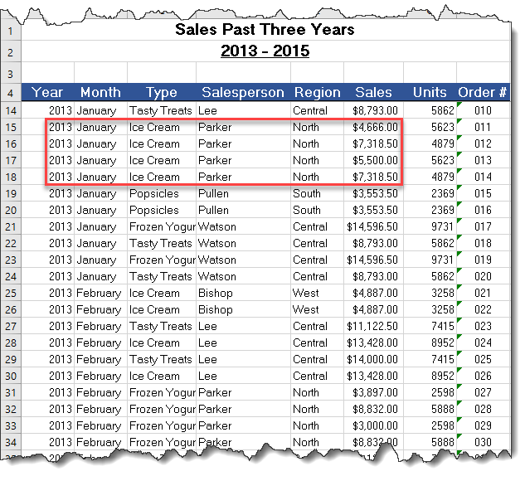
Challenges
Raw data unorganized
Excel Chart will display EACH item but in a form of chart,

Slide 5
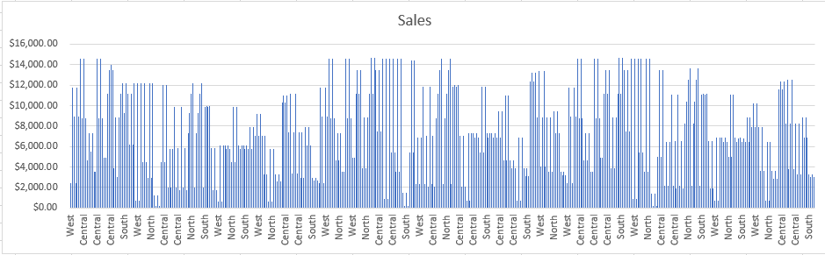
Which Region has the highest sales?
Chart with unorganized data will make less sense:

Slide 6
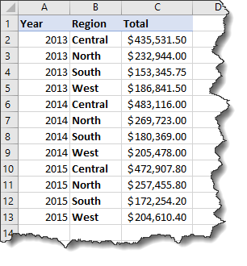
Solution-
Cleanup the data
Group each year’s sales by Region:

Slide 7
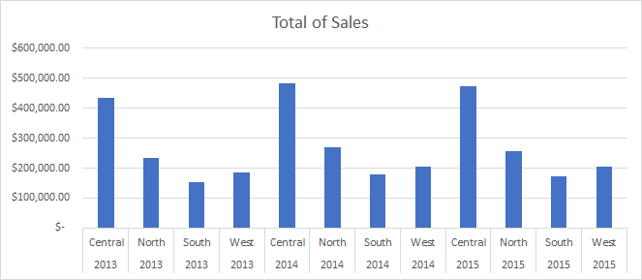
Which Region has the highest sales?

Slide 8
2. Create a pivot table and group data based on salesperson.

Slide 9
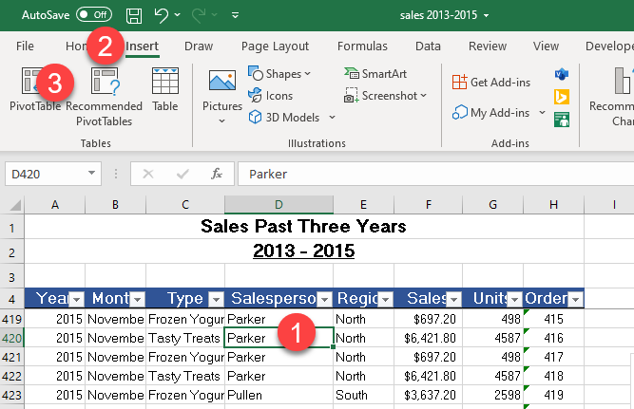
Procedure
Click on anywhere inside the table
Click on Insert
Click on PivotTable
A new dialogue window opens.

Slide 10
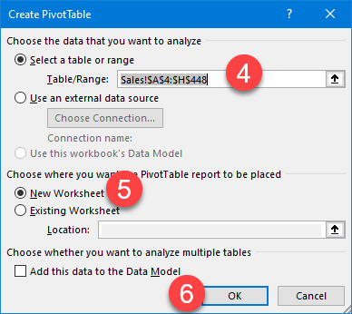
Procedure Cont.
4. Data range being auto selected. Review or modify if needed.
5. Select if need to pull pivot table in a new worksheet.
6. Click on OK.
A new worksheet being added automatically.

Slide 11
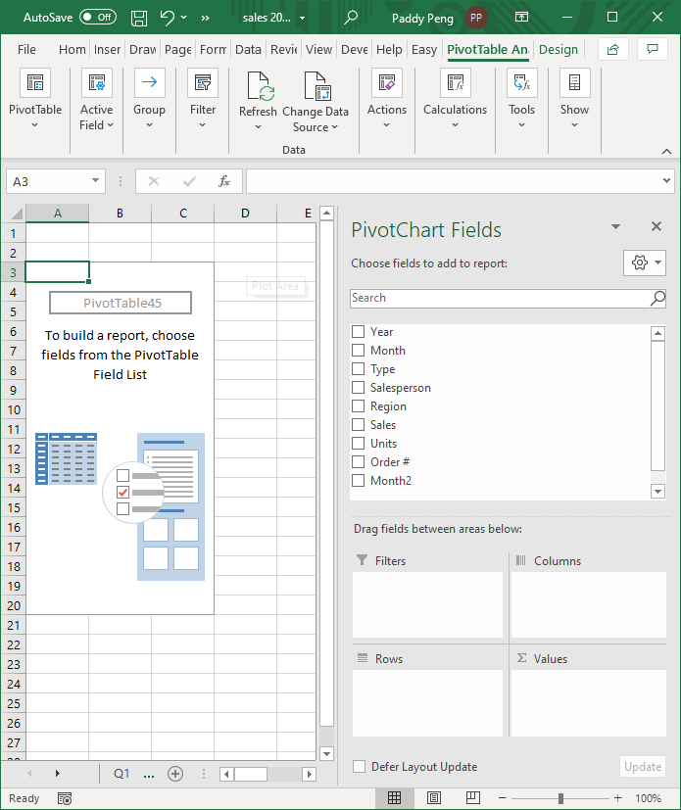
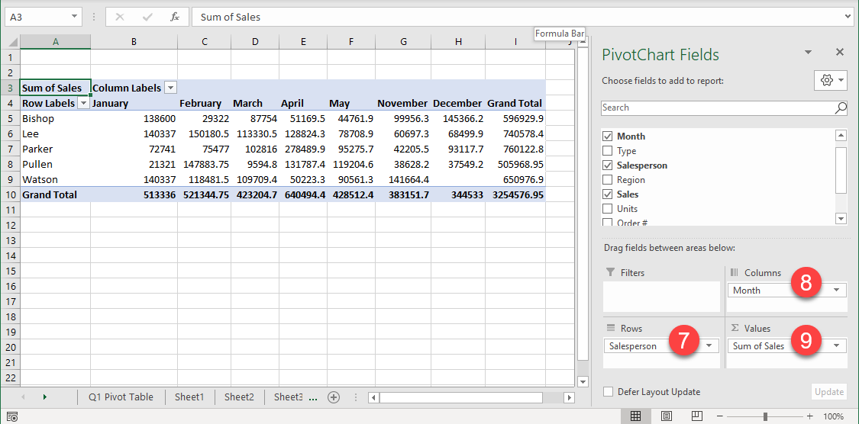
Procedure Cont.
An empty pivot table is ready to start.
Assume I need to see each salesperson’s monthly sales:
7. Drag & Drop Salesperson to Rows
8. Drag & Drop Month to Columns
9. Drag & Drop Sales to Values

Slide 12
3. Create a shape object and assign a macro to it that displays in message the current date.

Slide 13
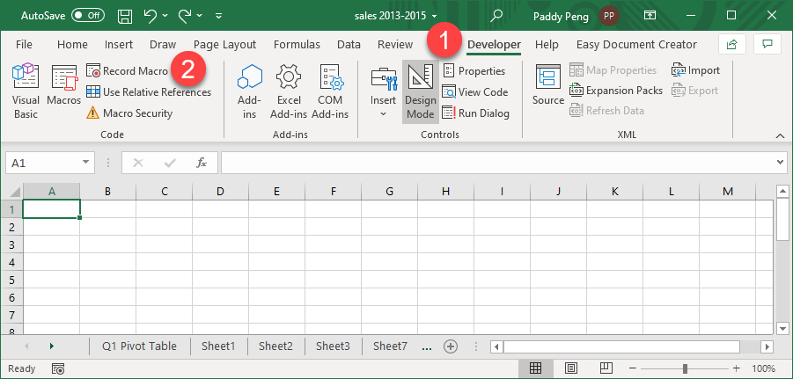
Procedure 1: Record Macro
Click on Developer
Click on Record Macro
In the next video, I recorded how to merge a few cells, and enter the formula of Today(), then format the merged cell.
Once done, STOP the Macro recording.

Slide 14

Procedure 2: Apply Macro

Slide 15
4. Create a procedure that declares variables of type string and integer.

Slide 16
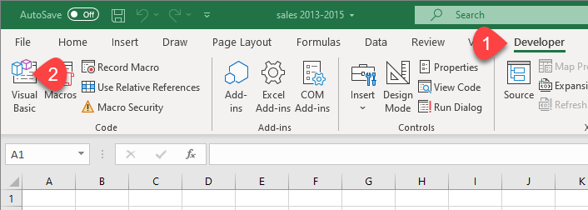
Code a Sub Procedure in VBE
Click on Developer
Click on Visual Basic
VBE (Visual Basic Environment) window opens.

Slide 17
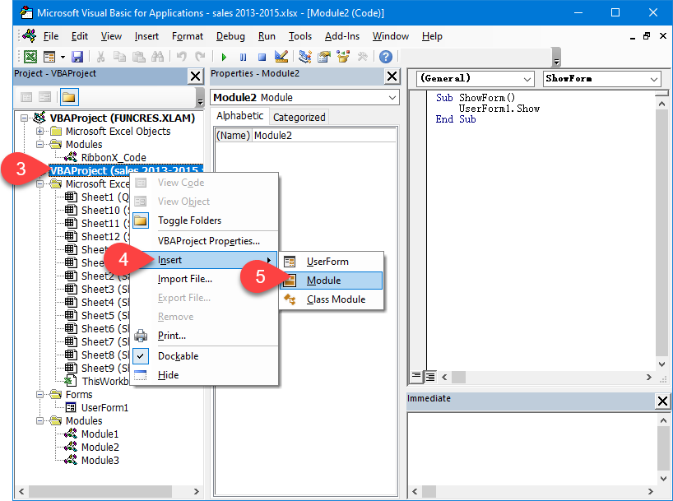
Code a Sub Procedure in VBE (cont.)
3. Right-click Project (Excel file) name
4. Click on Insert
5. Click on Module
A new Module (in this case, Mudule 4 will be added into Modules list.

Slide 18
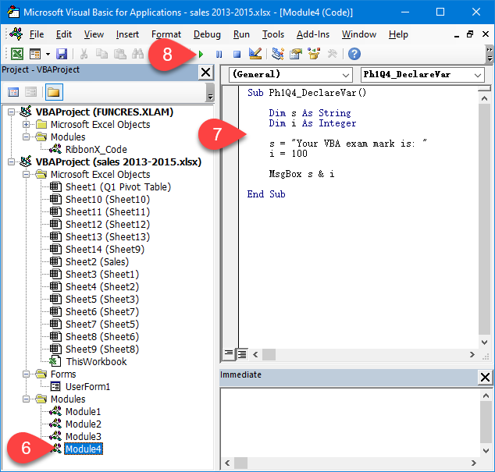
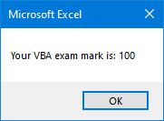
Code a Sub Procedure in VBE (cont.)
6. Click on new Module just created.
7. Coding as per project needed.
8. Click on the Play button.
Result shows up in Excel.

Slide 19
Project Phase 2
Create a VBA procedure that changes the font color of table to bold.
Create a VBA procedure that adds a yellow explanation column to right of table.(the header of that column is explanation and fill that column by yellow)
Create a VBA procedure that uses loop.
Create a message box that displays number of executions of one procedure
Create a user Form that has two text boxes and a button to calculate sum and show it in a message box.
create a User Form in Excel VBA to get name , date of birth , gender, telephone number, email , and postal code from the user and store the value provided by the user in the worksheet
VBA

Slide 20
Create a VBA procedure that changes the font color of table to bold.

Slide 21
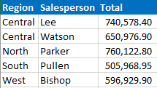
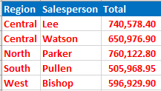
Sub Ph2Q1_TableFontColor()
I recorded below actions in Macro to create the VBA procedure.
Select table
Change font from regular in black to bold in red.

Slide 22
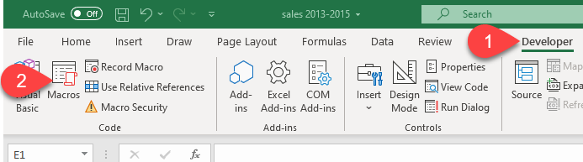
Sub Ph2Q1_TableFontColor()-cont.
Edit/Review Macro code in VBE:
Click on Developer
Click on Macros
A Macro dialogue window opens.

Slide 23
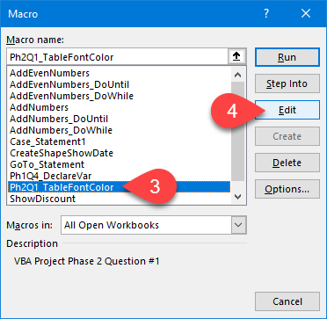
Sub Ph2Q1_TableFontColor()-cont.
Edit/Review Macro code in VBE:
3. Select Macro’s name
4. Click on Edit
VBE window opens

Slide 24
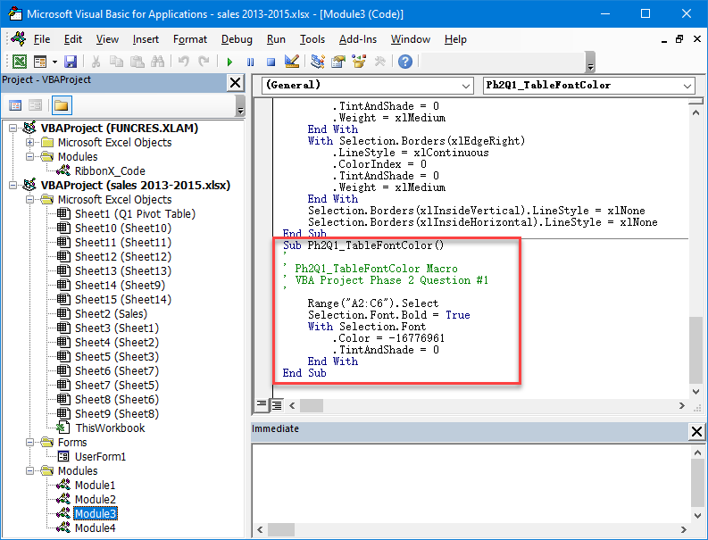
Sub Ph2Q1_TableFontColor()-cont.
Edit/Review Macro code in VBE:
Sub Ph2Q1_TableFontColor()
'
' Ph2Q1_TableFontColor Macro
' VBA Project Phase 2 Question #1
'
Range("A2:C6").Select
Selection.Font.Bold = True
With Selection.Font
.Color = -16776961
.TintAndShade = 0
End With
End Sub

Slide 25
2. Create a VBA procedure that adds a yellow explanation column to right of table.(the header of that column is explanation and fill that column by yellow)

Slide 26
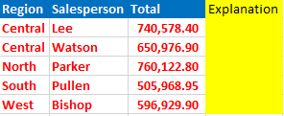
Sub Ph2Q2_AddYellowColumn()
I recorded below actions in Macro to create the VBA procedure.
Select the column on the right side of the table
Fill cell color to Yellow
Enter “Explanation” in the header

Slide 27
Sub Ph2Q2_AddYellowColumn()-cont.
Edit/Review Macro code in VBE:
Click on Developer
Click on Macros
A Macro dialogue window opens.

Slide 28
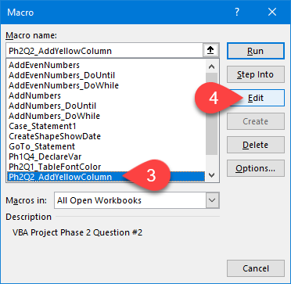
Sub Ph2Q2_AddYellowColumn()-cont.
Edit/Review Macro code in VBE:
3. Select Macro’s name
4. Click on Edit
VBE window opens

Slide 29
Sub Ph2Q2_AddYellowColumn()-cont.
Original Macro code in VBE:
After cleanup the code in VBE:
Sub Ph2Q2_AddYellowColumn()
Range("D1:D6").Select
With Selection.Interior
.Color = 65535
End With
Range("D1").Select
ActiveCell.FormulaR1C1 = "Explanation"
Columns("D:D").EntireColumn.AutoFit
End Sub
Sub Ph2Q2_AddYellowColumn()
'
' Ph2Q2_AddYellowColumn Macro
' VBA Project Phase 2 Question #2
'
Range("D1:D6").Select
With Selection.Interior
.Pattern = xlSolid
.PatternColorIndex = xlAutomatic
.Color = 65535
.TintAndShade = 0
.PatternTintAndShade = 0
End With
Range("D1").Select
ActiveCell.FormulaR1C1 = "Explanation"
Range("D2").Select
Columns("D:D").EntireColumn.AutoFit
End Sub

Slide 30
3. Create a VBA procedure that uses loop.

Slide 31
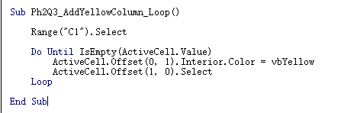
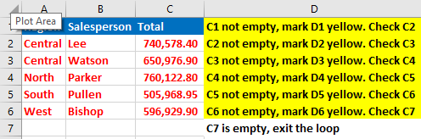
Sub Ph2Q3_AddYellowColumn_Loop()
I used a loop to do the same thing as in Q2, add a yellow column to the right of a table.
Assumption: Table has no empty cells, especially the last column.
My thoughts：Do Until loop
Start from the 1st cell in the last column, as long as this cell is not empty, mark the cell to its right to Yellow.
Move to the 2nd cell and do the same.
Stop until reach to an empty cell.

Slide 32
4. Create a message box that displays number of executions of one procedure

Slide 33
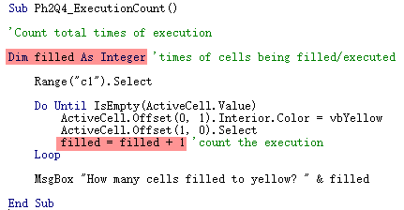
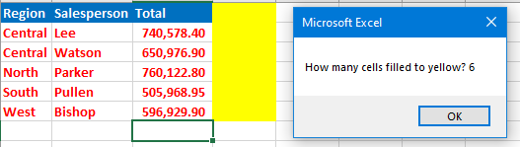
Sub Ph2Q4_ExecutionCount()
I want to know how many cells in total being filled to yellow...
To do this, I declared a variable filled as integer.
Everytime once a cell being filled into yellow, filled increased by 1.
Use MsgBox to display filled.
Here is the code:

Slide 34
5. Create a user Form that has two text boxes and a button to calculate sum and show it in a message box.

Slide 35
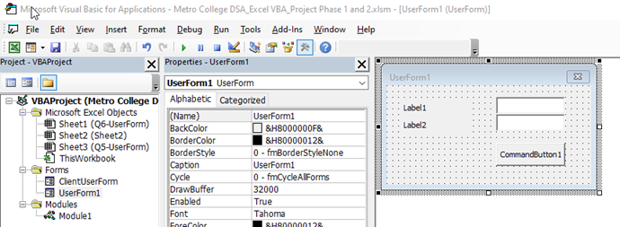
Sub Ph2Q5_AddUpForm()
DESIGN THE FORM

Slide 36
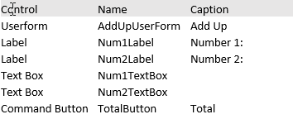
Sub Ph2Q5_AddUpForm()
Change the Names and Captions of the controls according to the below table.

Slide 37
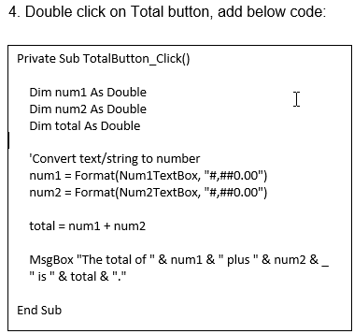
Sub Ph2Q5_AddUpForm()

Slide 38
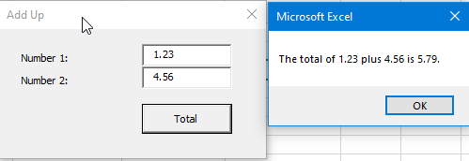
Sub Ph2Q5_AddUpForm()

Slide 39
6. create a User Form in Excel VBA to get name , date of birth , gender, telephone number, email , and postal code from the user and store the value provided by the user in the worksheet.

Slide 40
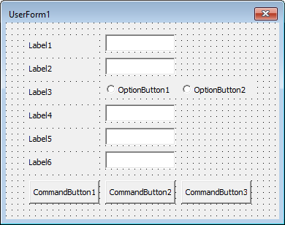
Sub Ph2Q5_AddUpForm()

Slide 41
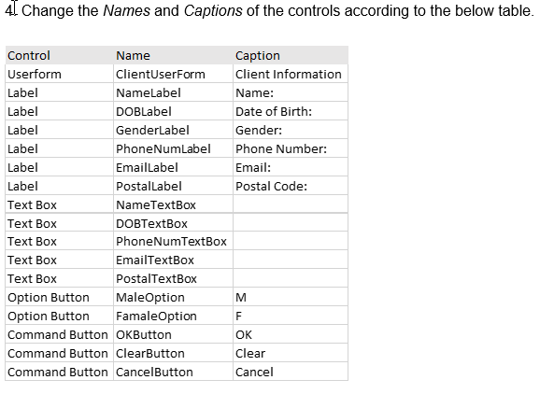
Sub Ph2Q5_AddUpForm()

Slide 42
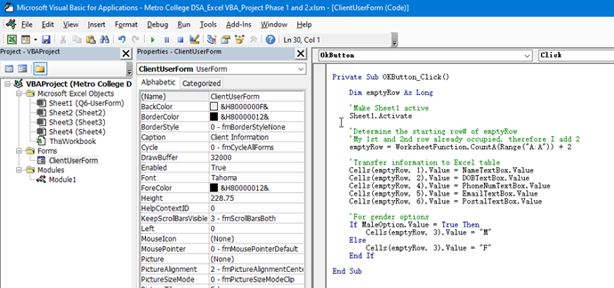
Sub Ph2Q5_AddUpForm()

Slide 43
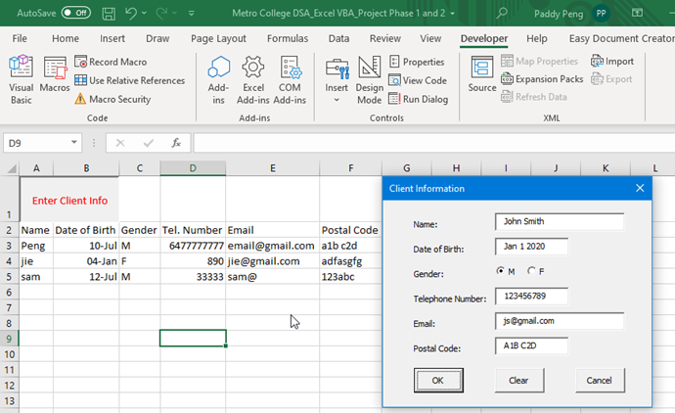
Sub Ph2Q5_AddUpForm()
Click Run in VBE or click Enter Client Info button in Excel. Client Information form opens. Enter the required information. The data entered will be transferred/recorded into Excel.

Slide 44
Questions?

